Slide 1
The Pac-Man Projects
P0: UNIX/Python Tutorial
P1: Search
P2: Multi-Agent Search
P3: Reinforcement Learning
P4: BNs and HMMs: Ghostbusters
P5: Machine Learning: Classification

Slide 2
Project 2: Multi-Agent Search
http://inst.cs.berkeley.edu/~cs188/sp20/project2/

Slide 3
Welcome to Multi-Agent Pacman
http://inst.cs.berkeley.edu/~cs188/sp20/project2/#welcome-to-multi-agent-pacman

Slide 4

Adversarial Search

Slide 5
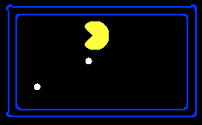
Single-Agent Trees
8
2
0
…
2
6
…
4
6

Slide 6
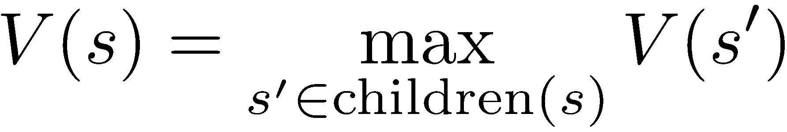

Value of a State
Value of a state: The best achievable outcome (utility) from that state
Non-Terminal States:
8
2
0
…
2
6
…
4
6
Terminal States:

Slide 7

Adversarial Game Trees
-20
-8
…
-18
-5
…
-10
+4
-20
+8

Slide 8

Evaluation Functions

Slide 9
Question 1 (4 points): Reflex Agent
http://inst.cs.berkeley.edu/~cs188/sp20/project2/#question-1-4-points-reflex-agent

Slide 10
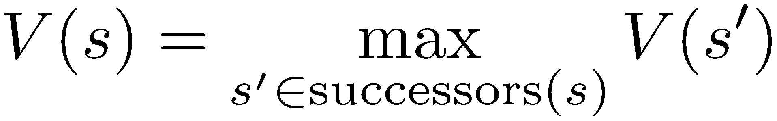
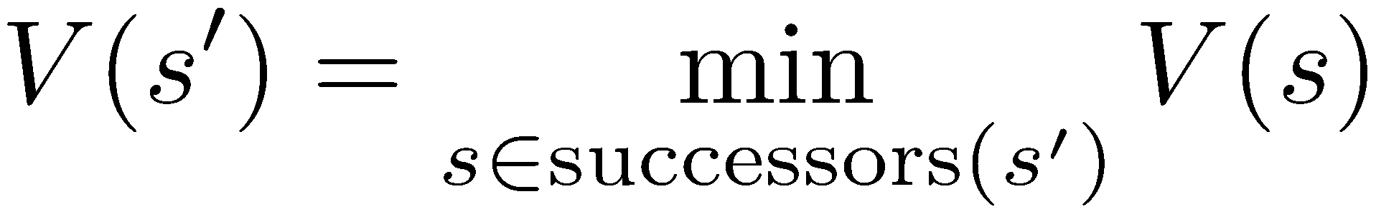
Minimax Values
States Under Agent’s Control:
States Under Opponent’s Control:
-8
-5
-10
+8
Terminal States:

Slide 11
Adversarial Search (Minimax)
Deterministic, zero-sum games:
Tic-tac-toe, chess, checkers
One player maximizes result
The other minimizes result
Minimax search:
A state-space search tree
Players alternate turns
Compute each node’s minimax value: the best achievable utility against a rational (optimal) adversary
Minimax values: computed recursively
5
max
2
5
min
8
2
5
6
Terminal values: part of the game

Slide 12
Minimax Implementation
def max-value(state):
initialize v = -∞
for each successor of state:
v = max(v, min-value(successor))
return v
def min-value(state):
initialize v = +∞
for each successor of state:
v = min(v, max-value(successor))
return v

Slide 13
Minimax Implementation (Dispatch)
def value(state):
if the state is a terminal state: return the state's utility
if the next agent is MAX: return max-value(state)
if the next agent is MIN: return min-value(state)
def max-value(state):
initialize v = -∞
for each successor of state:
v = max(v, value(successor))
return v
def min-value(state):
initialize v = +∞
for each successor of state:
v = min(v, value(successor))
return v
Notes:
Pick an order for two reasons: sequential processor and pruning

Slide 14
Minimax Example
3
12
8
2
4
6
14
5
2

Slide 15

Resource Limits

Slide 16
Resource Limits
Problem: In realistic games, cannot search to leaves!
Solution: Depth-limited search
Instead, search only to a limited depth in the tree
Replace terminal utilities with an evaluation function for non-terminal positions
Example:
Suppose we have 100 seconds, can explore 10K nodes / sec
So can check 1M nodes per move
α-β reaches about depth 8 – decent chess program
Guarantee of optimal play is gone
More plies makes a BIG difference
Use iterative deepening for an anytime algorithm
max
4
-2
4
min
-1
-2
4
9
?
?
?
?

Slide 17


Depth Matters
Evaluation functions are always imperfect
The deeper in the tree the evaluation function is buried, the less the quality of the evaluation function matters
An important example of the tradeoff between complexity of features and complexity of computation
[Demo: depth limited (L6D4, L6D5)]

Slide 18

Video of Demo Limited Depth (2)

Slide 19
Video of Demo Limited Depth (10)

Slide 20
Question 2 (5 points): Minimax
http://inst.cs.berkeley.edu/~cs188/sp20/project2/#question-2-5-points-minimax

Slide 21
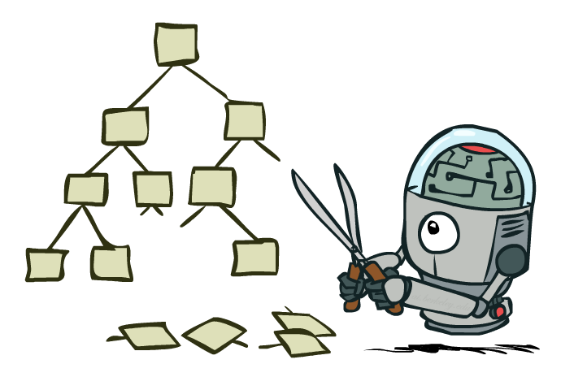
Game Tree Pruning

Slide 22
Minimax Example
3
12
8
2
4
6
14
5
2

Slide 23
Minimax Pruning
3
12
8
2
14
5
2

Slide 24
Alpha-Beta Pruning
General configuration (MIN version)
We’re computing the MIN-VALUE at some node n
We’re looping over n’s children
n’s estimate of the childrens’ min is dropping
Who cares about n’s value? MAX
Let a be the best value that MAX can get at any choice point along the current path from the root
If n becomes worse than a, MAX will avoid it, so we can stop considering n’s other children (it’s already bad enough that it won’t be played)
MAX version is symmetric
MAX
MIN
a
MAX
MIN
n

Slide 25
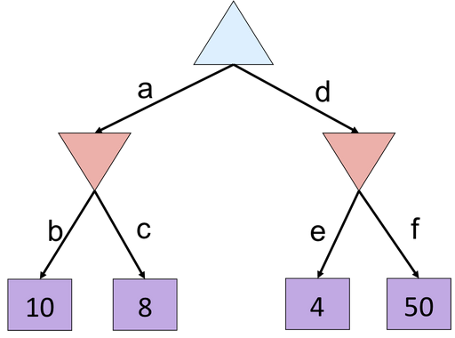
Alpha-Beta Quiz

Slide 26
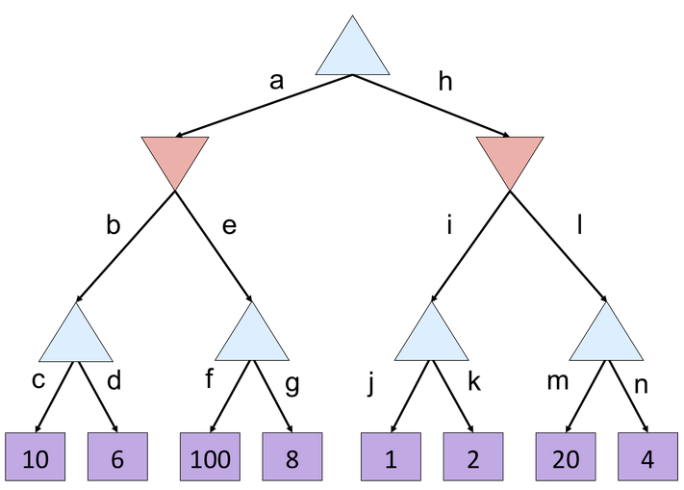
Alpha-Beta Quiz 2

Slide 27
Alpha-Beta Implementation
α: MAX’s best option on path to root
β: MIN’s best option on path to root
def max-value(state, α, β):
initialize v = -∞
for each successor of state:
v = max(v, value(successor, α, β))
if v ≥ β return v
α = max(α, v)
return v
def min-value(state , α, β):
initialize v = +∞
for each successor of state:
v = min(v, value(successor, α, β))
if v ≤ α return v
β = min(β, v)
return v
Notes:
Pick an order for two reasons: sequential processor and pruning

Slide 28
Question 3 (5 points): Alpha-Beta Pruning
http://inst.cs.berkeley.edu/~cs188/sp20/project2/#question-3-5-points-alpha-beta-pruning

Slide 29
Video of Demo Min vs. Exp (Min)

Slide 30
Video of Demo Min vs. Exp (Exp)

Slide 31
Expectimax Search
Why wouldn’t we know what the result of an action will be?
Explicit randomness: rolling dice
Unpredictable opponents: the ghosts respond randomly
Actions can fail: when moving a robot, wheels might slip
Values should now reflect average-case (expectimax) outcomes, not worst-case (minimax) outcomes
Expectimax search: compute the average score under optimal play
Max nodes as in minimax search
Chance nodes are like min nodes but the outcome is uncertain
Calculate their expected utilities
I.e. take weighted average (expectation) of children
Later, we’ll learn how to formalize the underlying uncertain-result problems as Markov Decision Processes
max
chance
10
10
4
10
5
9
7
100
[Demo: min vs exp (L7D1,2)]

Slide 32
Expectimax Pseudocode
def value(state):
if the state is a terminal state: return the state’s utility
if the next agent is MAX: return max-value(state)
if the next agent is EXP: return exp-value(state)
def max-value(state):
initialize v = -∞
for each successor of state:
v = max(v, value(successor))
return v
def exp-value(state):
initialize v = 0
for each successor of state:
p = probability(successor)
v += p * value(successor)
return v
Notes:
Pick an order for two reasons: sequential processor and pruning

Slide 33
Expectimax Pseudocode
def exp-value(state):
initialize v = 0
for each successor of state:
p = probability(successor)
v += p * value(successor)
return v
1/2
1/6
1/3
5
8
7
24
-12
v = (1/2) (8) + (1/3) (24) + (1/6) (-12) = 10

Slide 34
Expectimax Example
8
4
7
3
12
9
2
4
6
15
6
0

Slide 35
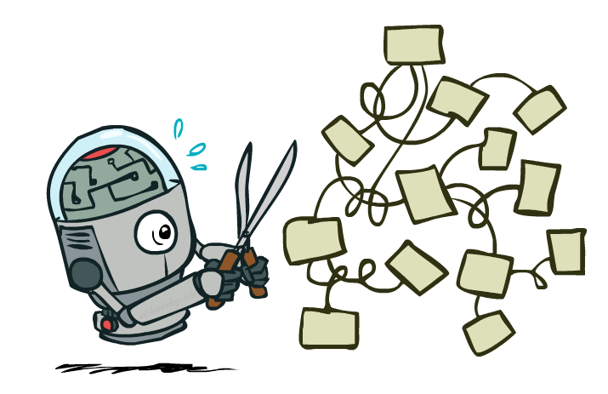
Expectimax Pruning?
3
12
9
2

Slide 36



Depth-Limited Expectimax
Estimate of true expectimax value (which would require a lot of work to compute)
400
300
…
…
492
362
…

Slide 37

Probabilities

Slide 38

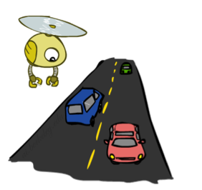
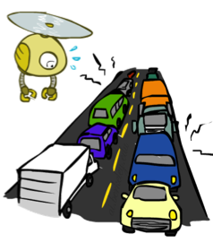
Reminder: Probabilities
A random variable represents an event whose outcome is unknown
A probability distribution is an assignment of weights to outcomes
Example: Traffic on freeway
Random variable: T = whether there’s traffic
Outcomes: T in {none, light, heavy}
Distribution: P(T=none) = 0.25, P(T=light) = 0.50, P(T=heavy) = 0.25
Some laws of probability (more later):
Probabilities are always non-negative
Probabilities over all possible outcomes sum to one
As we get more evidence, probabilities may change:
P(T=heavy) = 0.25, P(T=heavy | Hour=8am) = 0.60
We’ll talk about methods for reasoning and updating probabilities later
0.25
0.50
0.25

Slide 39

Reminder: Expectations
The expected value of a function of a random variable is the average, weighted by the probability distribution over outcomes
Example: How long to get to the airport?
Time:
20 min
30 min
60 min
+
+
35 min
x
x
x
Probability:
0.25
0.50
0.25

Slide 40
Question 4 (5 points): Expectimax
http://inst.cs.berkeley.edu/~cs188/sp20/project2/#question-4-5-points-expectimax

Slide 41
Video of Demo World Assumptions Random Ghost – Expectimax Pacman

Slide 42
Video of Demo World Assumptions Adversarial Ghost – Minimax Pacman

Slide 43
Video of Demo World Assumptions Adversarial Ghost – Expectimax Pacman

Slide 44
Video of Demo World Assumptions Random Ghost – Minimax Pacman

Slide 45
课后作业： Question 5 (6 points): Evaluation Function
http://inst.cs.berkeley.edu/~cs188/sp20/project2/#question-5-6-points-evaluation-function

